Slide 1
SPACE COORDINATES

Slide 2
SPACE COORDINATES
(THREE-DIMENSIONAL COORDINATE SYSTEM)
Many of the formulas we will develop for space coordinates are “extensions” of the corresponding formulas in two dimensions. For this purpose our coordinates system is extended to three dimensions.
In the figure, OX, OY and OZ are three mutually perpendicular lines. These lines are the x-axis, the y-axis and the z-axis of a three-dimensional rectangular coordinate system.
The axes, in pair, determine three mutually perpendicular planes called coordinate planes. The planes are designated the x-y plane, the x-z plane and the y-z plane. The coordinate planes divide the space into eight regions,
also known as the octants.

Slide 3
Z – axis
Y - axis
O
X - axis

Slide 4
Definitions
• P (x,y,z) - the coordinates of the point in the space. Its position in this coordinate system is determine by its distances from the coordinate planes.
• X – coordinate - it is the distance from the y-z plane.
• Y – coordinate - it is the distance from the x-z plane.
• Z – coordinate - it is the distance from the x-y plane.

Slide 5
Example 1: Plot the following points:
a. P₁ (5, -6, 6)
b. P₂ (-1, -4, 8)
c. P₃ (3, 5, 5)
d. P₄ (-2, 6, -3)
e. P₅ (2, -3, -7)

Slide 6
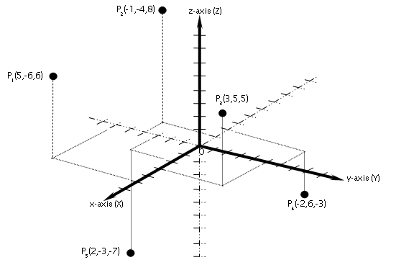

Slide 7
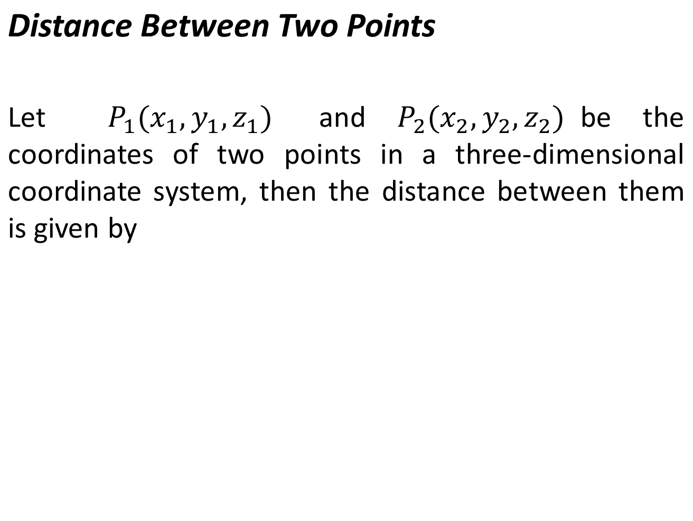

Slide 8
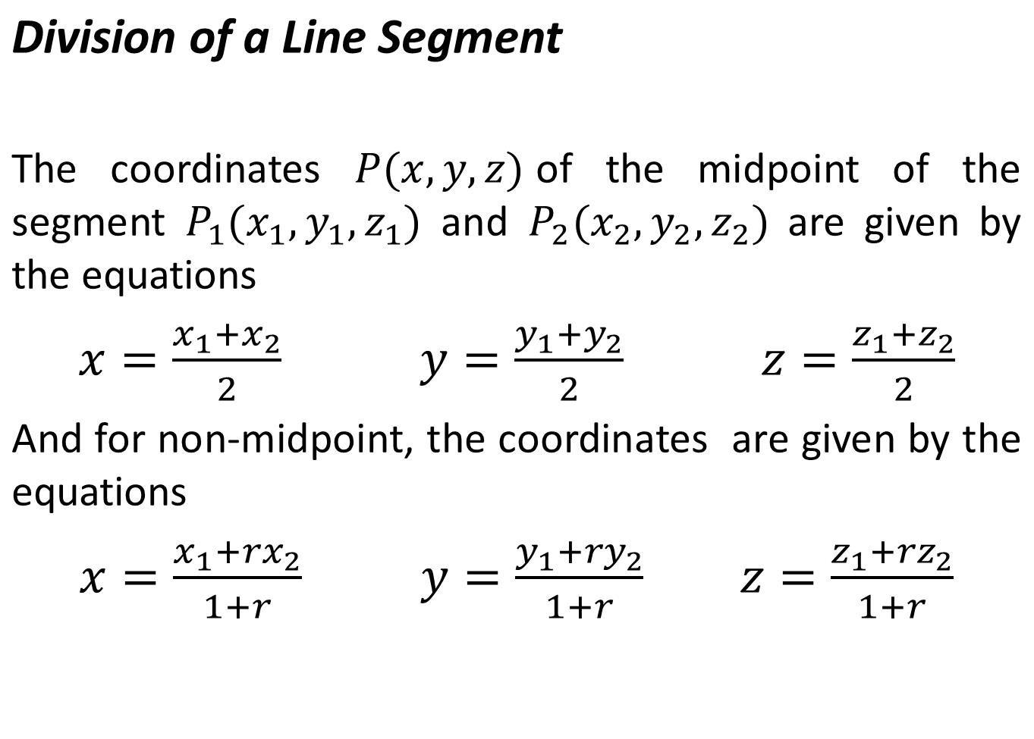

Slide 9
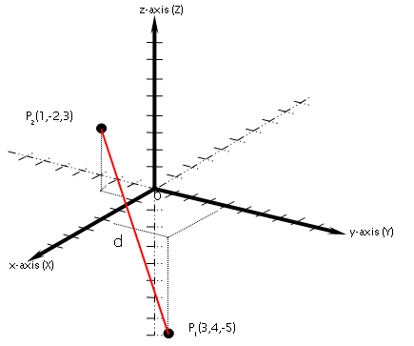
Example 2:
Find the distance between the points P₁(3, 4, -5) and P₂(1, -2, 3).

Slide 10
Example no. 3
Find the midpoint of the line segment from P₁(3, 4, -5) and P₂(1, -2, 3).
Example no. 4
Find the coordinate of the point that is two-thirds of the way from P₁(3, 4, -5) and P₂(1, -2, 3).

Slide 11
End of Discussion

